Slide 1
Software Engineering and Professional Practice. Building Usable Software. Unit 5: Software Testing and Quality Assurance Part 2: Software Quality
Anis Zarrad
a.zarrad@bham.ac.uk

Slide 2
Outlines – Week 6
Introduction
Software Quality
Quality assurance and control
McCall’s Quality Model
Software Testing
Testing Levels
Testing Strategies
Black-Box testing
White-Box Testing
Testing Plan

Slide 3
Black-Box Testing

Slide 4
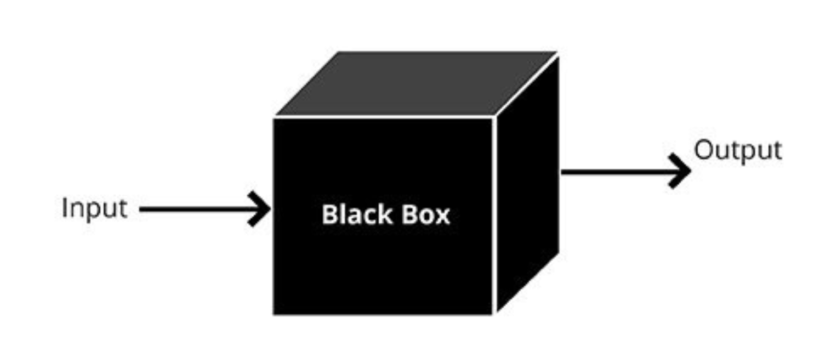
Types of Software Testing
Black-Box
White-Box
Black-box testing (functional testing)
is based on the definition of what a (or a piece of) program is intended to do
uses program’s specification rather than its structure
Later stage
Black-box is a complementary approach

Slide 5
Techniques in Black-Box Testing
Equivalence Partitioning.
Boundary value analysis.
Decision table
State transition.

Slide 6
Black-Box Testing Equivalence Class Partitioning
An equivalence class is a group of data values where the tester assumes that the test object process them in the same way.
The test of one representative of equivalence class is sufficient
It is assumed that for any other value of the same equivalence class the test object will have a similar behavior
Equivalence classes for incorrect values must be derived also

Slide 7
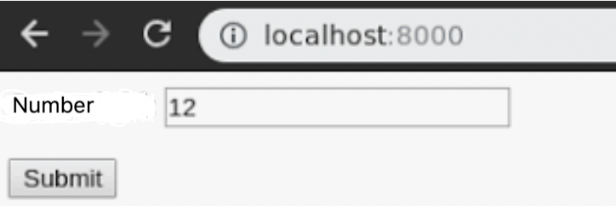
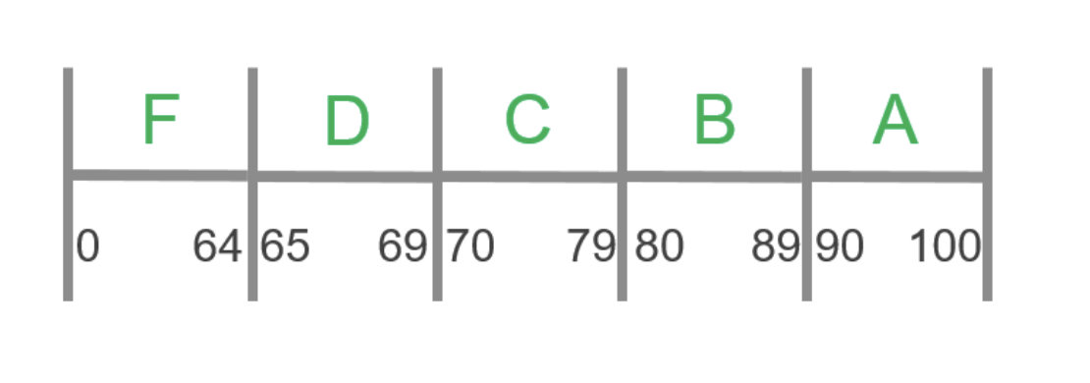
Equivalence Class Partitioning Example
234
65TDSE
UOB

Slide 8
Equivalence Class Partitioning Derivation of Test Cases
For every input data, the domain of all possible inputs should be determined.
The domain is partitioned into equivalence class of all correct input value.
Values outside of this domain are seen as equivalence classes with incorrect input value.
if specifies range of valid values, define
1 valid EC (within the range)
2 invalid EC (one outside each end of the range)
if specifies a number (N) of valid values, define
1 valid EC and
2 invalid ECs (none and more than N)
if specifies a set of valid values, define
1 valid EC (within set) and
1 invalid EC (outside set)
-2
5
17
x < 1
1 ≤ x ≤ 12
12 < x
autocolor:{red, blue, green}

Slide 9
Equivalence Class Partitioning Example
Consider the following hiring system in UoB. The system decides how we should process employment application based on the person age:
0-16 Don’t hire
17- 20 can hire as a part time
21-55 can hire as a full time
56-99 don’t hire
It is clear that for the first requirement we don’t have to test 0, 1, 2 ..16. Only one value needs to be tested. Which one?
Using the equivalence class approach, we have reduced the number of test cases from 100 to four.

Slide 10
Equivalence Classes Partitioning - Problems
Specification doesn't always define expected output for invalid test-cases
Strongly typed languages eliminate the need for the consideration of some invalid inputs.
Equivalence class partitioning assumes all members of a partitioned class will have the same impact on a function and this isn't always true.
Stack empty; stack full. These are the boundary conditions.
Test boundaries, How?
Boundary Value Analysis (BVA)

Slide 11
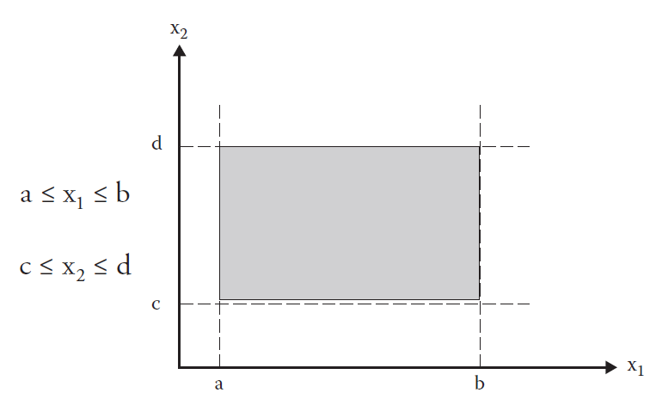
Black-Box Boundary Value Analysis
Boundary value analysis(BVA)is based on testing at the boundaries.
a test case design technique
complements to equivalence partitio
Rationale —> errors tend to occur near the extreme values of an input variable

Slide 12
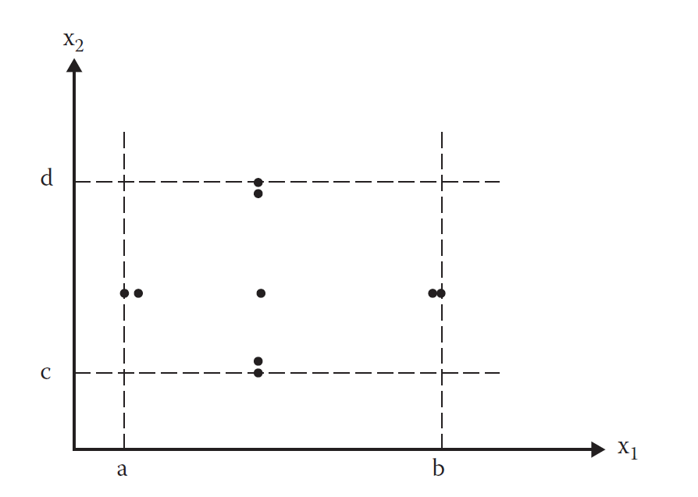

Normal BVA
User input values at
1) their minimum
2) just above the minimum,
3) a nominal value,
4) just below their maximum
5) at their maximum.
Function f that computes the number of test cases for a given number of variables n can be shown as:

Slide 13
Scenario
Input A
How many test cases are
needed to test the product
represented by this flowchart?
A<=25
Yes
No
N=1
So 5 test cases
A=0, A=1, A=15, A=24, A=25
End
Print A

Slide 14
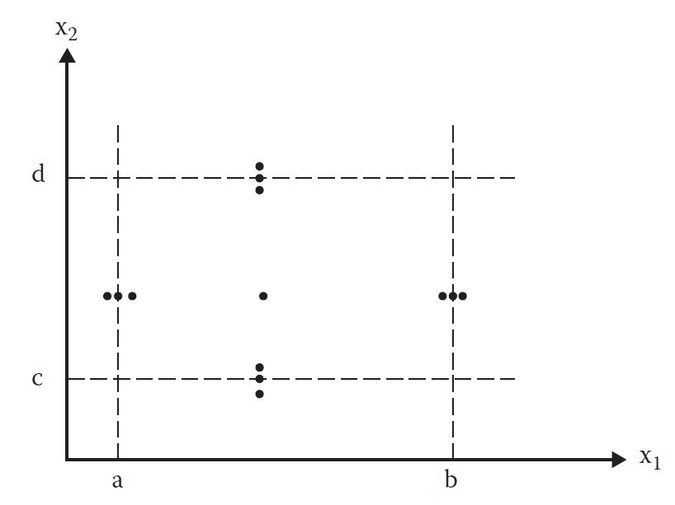
Robust BVT
extension to normal BVT —> extrema are exceeded with a value slightly greater than the maximum and a value slightly less than the minimum.
Function f that computes the number of test cases for a given number of variables n can be shown as:

Slide 15
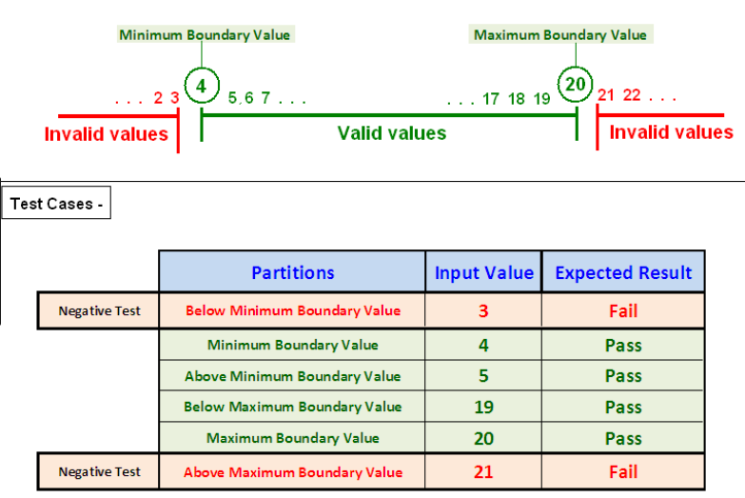
Robust BVA Example
As per requirements, the textbox should accept the values from 4 and 20

Slide 16
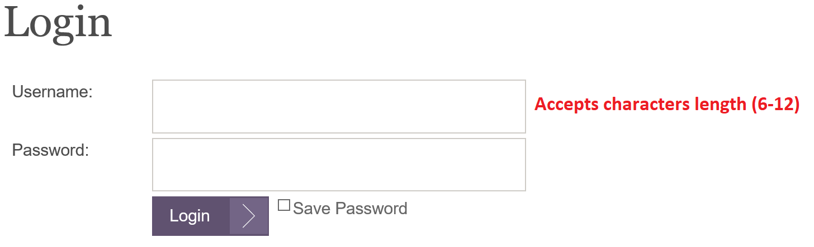
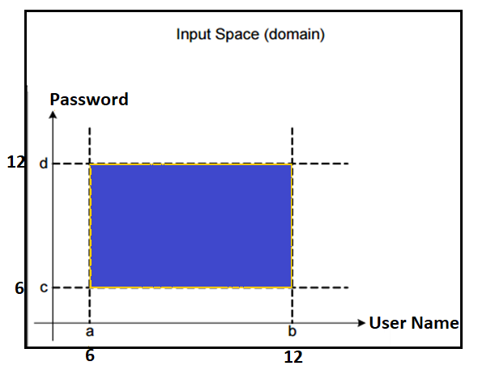
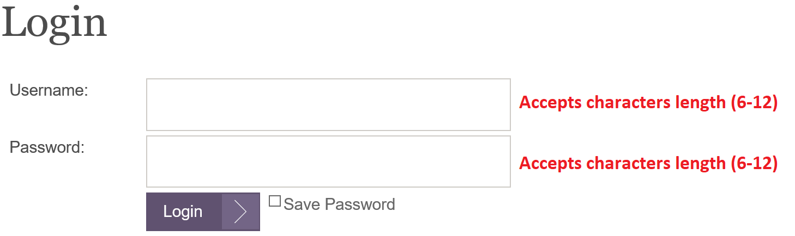
Black-Box Boundary Value Analysis-Robust
Invalid (min-1) | Valid (min, min+, max-, max) | Invalid (Max+1)
5 | 6, 7, 9, 11, 12 | 13
function CheckLength (int UserName, int Password)
A ≤ UserName ≤ B
C ≤ Password ≤ D

Slide 17
Practice
An online store offers different discounts depending on the purchases made by the individual. If a purchase is in the range of $1 up to $50 has no discounts, a purchase of $51 and up to $200 has a 5% discount, and purchases of $201 and up to $500 have a 10% discounts, and purchases of $501 and above have a 15% discounts.
Identify the equivalence class partitioning for this discounts system.
[1- 50], [51- 200], [201- 500], [501-n] – valid
Invalid [ –n, 0], [non-integer]
Identify the boundary values of each partition, Use Normal BVA
[1,50] -> 1,2, 20,49,50

Slide 18
Part 3
White-Box Testing

Slide 19
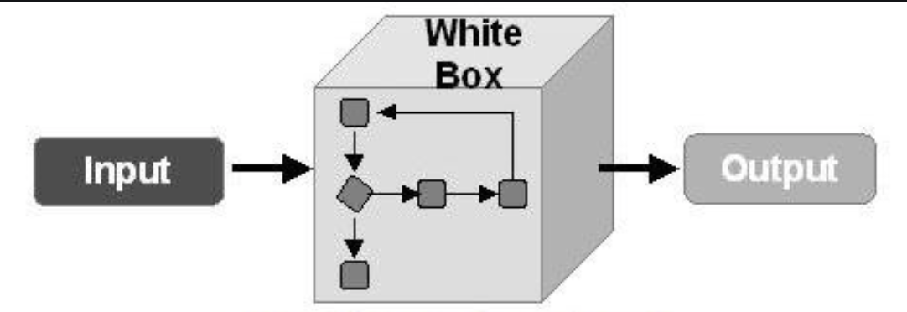
White-Box
White-Box testing is a verification technique software engineers can use to examine if their code works as expected
White-Box testing is also known as structural testing, clear box-testing, and glass box testing (Beizer, 1995).

Slide 20
White-Box Control-flow-based Testing
Step 1: From the source, create a graph describing the flow of control
Called the control flow graph
The graph is created (extracted from the source code) manually or automatically
Step 2: Design test cases to cover certain elements of this graph
Nodes (Statements), edges, paths

Slide 21
White-Box Control-flow-based Testing- GFG Elements
Three kinds of nodes:
Statement nodes: represent single-entry-single-exit sequences of statements
Predicate nodes: represent conditions for branching
Auxiliary nodes: (optional) for easier understanding (e.g., “join points” for IF, etc.)
Edges: represents possible flow of control

Slide 22
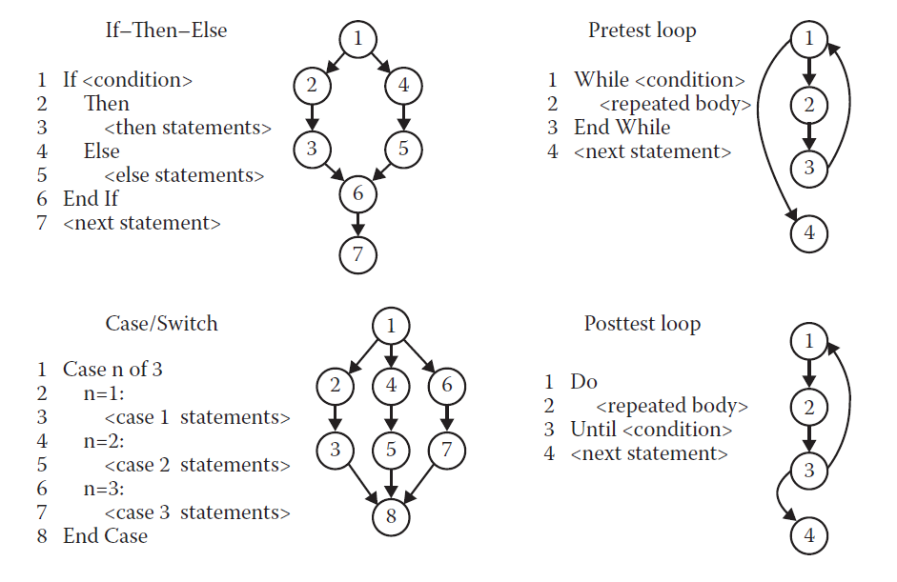
Control-flow Graph- CFG

Slide 23
White-Box Types of Logic Coverage
Statement: each statement executed at least once
Branch: each branch traversed (and every entry point taken) at least once
Condition: each condition True at least once and False at least once
Path: all program paths traversed at least once
Notes:
.

Slide 24
White-Box Statement Coverage
Basic idea: given the control flow graph define a “coverage target” and write test cases to achieve it
Traditional target: statement coverage
Need to write test cases that cover all nodes in the control flow graph
Can be defined as
Statement Coverage = (number of executed statements /Total number of statements) * 100%

Slide 25
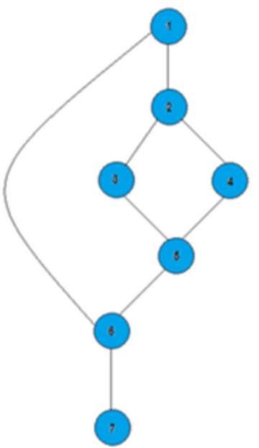
White-Box Statement Coverage- Example
1- Draw the CFG
2- Design test cases for 100% statement Coverage
1. If A=50
2. Then if B>C
3. Then A+B
4. Else A=C
5. End if
6. End if
7. Print A
(A=50, B=5, C=0)
(A= 50, B=5, C=100)
(A=7, B=5, C=0)

Slide 26
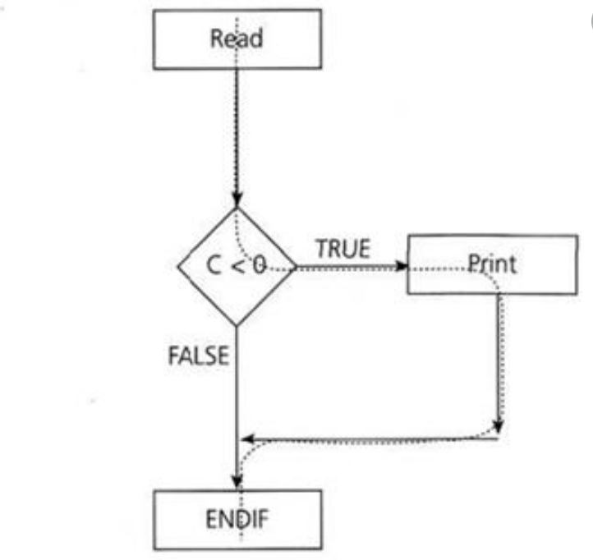
White-Box Branch / Condition Coverage
More advanced criterion for white box testing
Target: write test cases that cover all branches
True and false branches of each IF
The two branches corresponding to the condition of a loop
The degree of coverage for branch coverage is defined as :
Branch coverage = (number of executed branches / total number of branches)*100%
Statement coverage does not imply branch coverage
Can you think of an example?

Slide 27
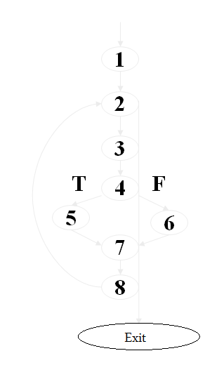
Activity
First path: 1-2-exit (no execution of the loop)
Second path:
we want to include edge 2-3, so we can
pick 1-2-3-4-5-7-8-2-exit
What would we pick for the third path?
1-2-3-4-6-7-8-2-exit

Slide 28
White-Box Testing Path Coverage
A path through a program:
A node and edge sequence from the starting node to a terminal node of the control flow graph.
Path Coverage requires that all program paths will have been traversed at least once.
Path Coverage is usually impossible when loops are present. (How many test cases would be required to cover all paths in the example below?)
repeat 29 times
3 X 3 X…X 3
= 3³⁰ paths

Slide 29
White-Box Testing Activity
1
How many paths?
path 1: 1-11
path 2: 1-2-3-4-5-10-1-11
path 3: 1-2-3-6-8-9-10-1-11
path 4: 1-2-3-6-7-9-10-1-11
2
3
4
6
7
8
5
9
10
11
Notes:
Path 5 is not considered to be an independent path because it’s simply a combination of the already specified paths (paths 2 and 3) and does not traverse any new edges

Slide 30
White-Box Testing Practice – Activity 1
if a then s1
else if b then s2
else if c then s3
else s4
end_if_then_else
end_if_then_else
end_if_then_else
Number of Paths: 4 Paths

Slide 31
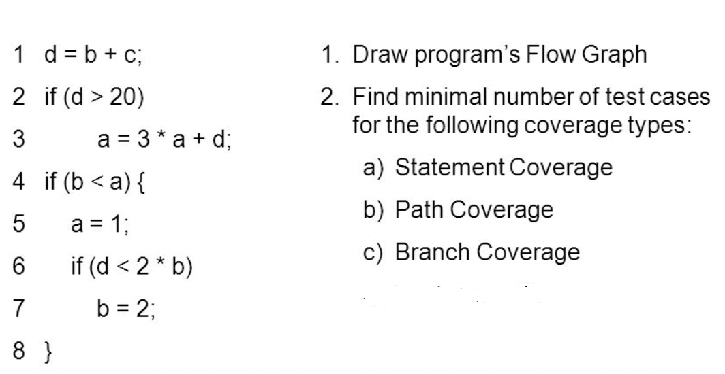
Practice

Slide 32
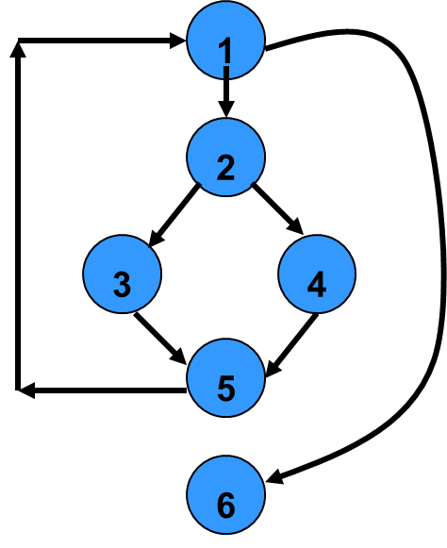
White-Box Testing Cyclomatic complexity
Given a control flow graph G, cyclomatic complexity V(G):
V(G)= E-N+2
N is the number of nodes in G
E is the number of edges in G
Another way of computing cyclomatic complexity:
inspect control flow graph
determine number of bounded areas in the graph or number of decisions in the source code
V(G) = Total number of bounded areas + 1
Any region enclosed by a nodes and edge sequence.

Slide 33
White-Box Testing Cyclomatic Complexity Interpretation
If value of Cyclomatic Complexity is more than 10, the structure of the module is overly complex. Thus ask the developer to re-construct the module.
If value of Cyclomatic Complexity is more than 5 and less than 10, the structure of the module is complex indicating that the logic is difficult to test. Thus such a module shall be allocated to experienced testers.
If value of Cyclomatic Complexity is less than 5, the structure of the module is simple indicating that the logic is easy to test. Thus such a module may be allocated to less experienced testers.

Slide 34
In General…
Number of program Paths
Number of Basis Paths
Number of test cases required for branch coverage
≥
≥
Basis Paths Coverage
Path Coverage
=>
=>
Branch Coverage

Slide 35
Part 4: Testing Plan

Slide 36
Testing plan
The goal of test planning is to establish the list of tasks which, if performed, will identify all of the requirements that have not been met in the software. The main work product is the test plan.
The test plan documents the overall approach to the test. In many ways, the test plan serves as a summary of the test activities that will be performed.
It shows how the tests will be organized, and outlines all of the testers’ needs which must be met in order to properly carry out the test.
The test plan should be inspected by members of the engineering team and senior managers.

Slide 37
Test Plan Outline (IEEE 829 FORMAT)
1) Test Plan Identifier
2) References
3) Introduction
4) Test Items
5) Software Risk Issues
6) Features to be Tested
7) Features not to be Tested
8) Approach
9) Item Pass/Fail Criteria
10) Suspension Criteria and Resumption Requirements
11) Test Deliverables
12) Remaining Test Tasks
13) Environmental Needs
14) Staffing and Training Needs
15) Responsibilities
16) Schedule
17) Planning Risks and Contingencies
18) Approvals
19) Glossary

Slide 38
Test Plan Outline (IEE 829)
1-Test plan identifier
Used to identify the plan
2-References
Mention all documents that supports this test plan. Example project plan, UML Diagrams, Standards and guidelines.

Slide 39
Test Plan Outline (IEE 829)
3-Introduction
State the purpose of the plan, specify the goals / objectives.
4- Test Items (Functions)
list of what is to be tested
Items should be within the scope of this test plan
Remember, what you are testing is what you intend to deliver to the client.

Slide 40
Test Plan Outline (IEE 829)
5-Software risk issues
Identify what the critical areas are?
6-Features to be tested
This is a listing of what is to be tested from the USERS viewpoint.
7-Features not to be tested
This is a listing of what is NOT to be tested from both the Users viewpoint and control view.

Slide 41
Test Plan Outline (IEE 829)
8- Approach(Strategy)
Mention the overall approach to testing.
Testing levels, testing methods
Quality factors to measure
Test-fix method
Test, analyze, and fix
Customized method

Slide 42
Test fix method
Defect detected
Open request
Assigned
close
Fixed
Retest
Fail

Slide 43
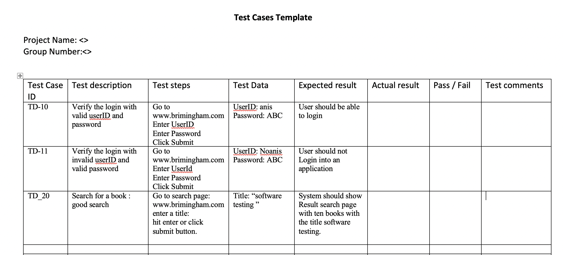
Test Plan Outline (IEE 829)
9- Item Pass/fail criteria
Prepare a set of test cases
Test case template

Slide 44
How to write a good test case.
Sort title
Strong and detailed description
Clear and concise
Include expected result
Make it reusable

Slide 45
Test Plan Outline (IEE 829)
10- Exit criteria
Specify the exit criteria(when stop testing)
11,- 18
Are related to the management process

Slide 46
Recap – What is required in your coursework Testing Plan Question.
3- Introduction
4-Test Items (Functions)
6-Features to be tested
7-Features not to be tested
8- Approach(Strategy)
9- Item Pass/fail criteria
10-Exit criteria
Assumptions

Slide 47
Questions

Slide 48
References
Curcio, Karina ; Malucelli, Andreia ; Reinehr, Sheila ; Paludo, Marco Antônio. “An analysis of the factors determining software product quality: A comparative study”. Computer Standards & Interfaces, November 2016, Vol.48, pp.10-18
Paul C. Jorgensen, “Software Testing – A Craftsman’s Approach” (Fourth Edition), CRC Press, 2014,
M. Hines, A. Goerner “Software quality: Attributes and modalities”. Transactions on information and Communications Technologies Vol 11, 1995
https://jmpovedar.files.wordpress.com/2014/03/ieee-829.pdf

